Slide 1
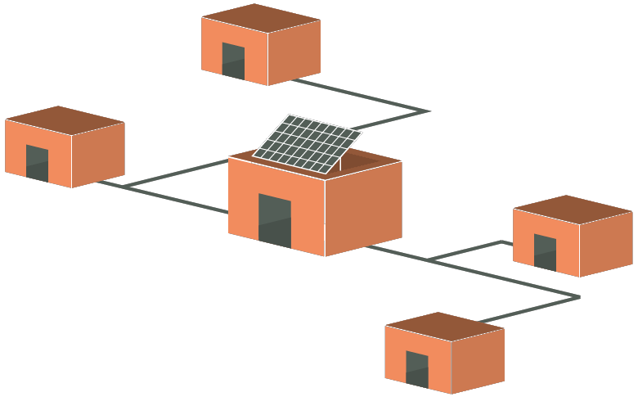
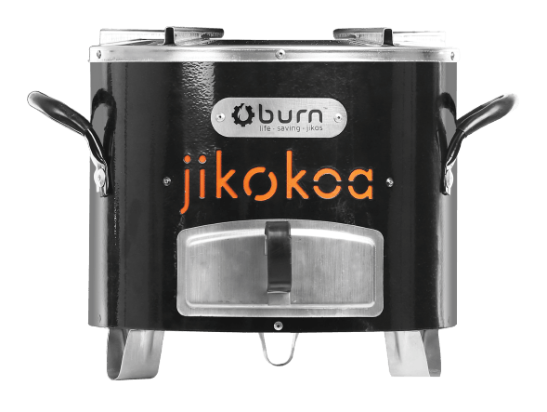
SolergieBox (SB) 3000 Solar Nano Grid System with EPC and Charcoal Improved Cookstoves
SolergieBox3000
Cost ~5.317 Euro
60-month contract
~80 Euro/month in Energy Subscription payments
5600 Wh/day
5 Customers per Box3000
5 ESS per SB3000
One SB3000 generates avg. $108 USD per month in ESS revenue
2 clients receive EPCs
3 Clients receive charcoal ICS
One client can also have a productive use product: freezer; refrigerator; phone charging station; barbershop; seamstress, etc.
Client #5
600 Wh/d
220V AC
JikoKoa Charcoal ICS
Pays 5 Euro/mo
Client #3
600 Wh/d
220V AC
JikoKoa Charcoal ICS
Freezer / micro-entrepreneur
Pays 9 Euro/mo
Client #2
2200 Wh/d
220V AC
1000W Ecoa EPC 6L
Pays ~33 Euro/mo
Client #4
300 Wh/d
220V AC
JikoKoa Charcoal ICS
Pays 5 Euro/mo
Client #1
2200 Wh/d
220V AC
1000W Ecoa EPC 6L
Pays ~33 Euro/mo
60 Month Contract (5-Years)

